Slide 1


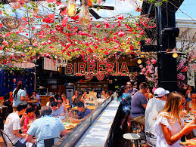
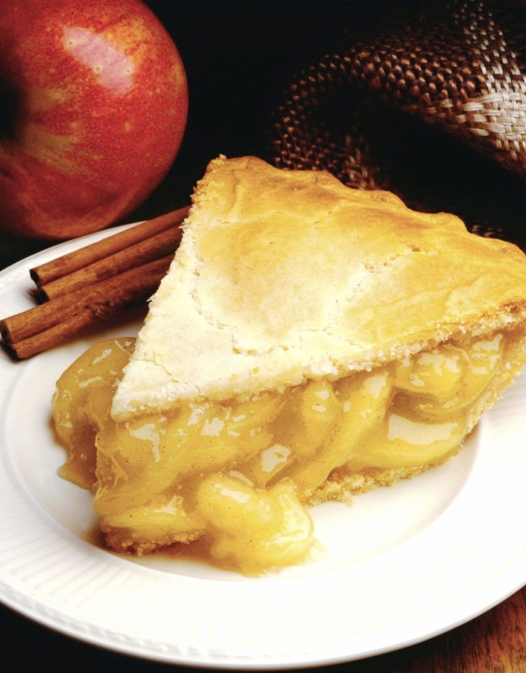
The Battle of Neighborhoods
Réalisé par : RAZZOUGUI Layla

Slide 2
INTRODUCTION
Business Problem :
Choice of first neighborhood to start restaurant business.
Easy to replicate.
Low competition
High demand
Choice of Menu
Success Criteria :
Best neighborhood which meets above criteria.
Notes:
2

Slide 3
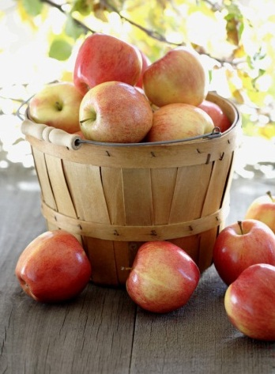
NEW YORK CITY – BUSINESS PROBLEME
Market is highly competitive
Highly developed city so cost of doing business is also one of the highest
New business venture or expansion needs to be analysed carefully
One should strategically targeting the market inorder to –
-This will help in reduction of risk.
-The Return on Investment will be reasonable

Slide 4
Dataset1: Description
Neighborhood has a total of 5 boroughs and 306 neighborhoods. In order to segment the neighborhoods and explore them, we will essentially need a dataset that contains the 5 boroughs and the neighborhoods that exist in each borough as well as the latitude and longitude coordinates of each neighborhood.
Link to the dataset : https://geo.nyu.edu/catalog/nyu_2451_34572

Slide 5
Dataset2 : Description
A farmers' market is often defined as a public site used by two or more local or regional producers for the direct sale of farm products to consumers. In addition to fresh fruits and vegetables, markets may sell dairy products, fish, meat, baked goods, and other minimally processed foods
Link : https://data.cityofnewyork.us/dataset/DOHMH-Farmers-Markets-and- Food-Boxes/8vwk-6iz2

Slide 6
Dataset3: Description
Data from Wikipedia pages as given below :
New York Population
New York City Demographics
Cuisine of New York city
https://en.wikipedia.org/wiki/New_York_City
https://en.wikipedia.org/wiki/Economy_of_New_York_City
https://en.wikipedia.org/wiki/Portal:New_York_City
https://en.wikipedia.org/wiki/Cuisine_of_New_York_City

Slide 7
Dataset3 : Description
Newyork city geographical coordinates data will be utilized as input for the Foursquare API, that will be leveraged to provision venues information for each neighborhood.We will use the Foursquare API to explore neighborhoods in New York City. The below is image of the Foursquare API data.
Link : www.foursquare.com

Slide 8
Analytic Approach
New York city neighbourhood has a total of 5 boroughs and 306 neighborhoods
PART 1 - Clustering of Manhattan and Brooklyn
PART 2 - Clustering of Bronx, Queens and Staten Island.
Only restaurant data is filtered from foursquare.com venues data and utilized for this project.

Slide 9
Methodology 1 | Methodology 2 | Methodology 3 | Methodology 4
Load the data and explore data -newyork_data.json Transform the data of nested python dictionaries into a pandas dataframe. Dataframe contains the geographical coordinates of New York city neighborhoods. Data will used to get Venues data from Foursquare. Geopy and folium libraries used to create a map of New York city with neighborhoods superimposed on top | In this we will be using the data of Farmers Markets There are totally 144 Farmers Markets in New York city. Highest number are in Manhattan and Brooklyn.And lowest in Queens, Bronx and Staten Island. | IN THIS DATASET We used BeautifulSoup python library. Beautiful Soup is a Python package for parsing HTML and XML documents (including having malformed markup, i.e. non-closed tags, so named after tag soup). It creates a parse tree for parsed pages that can be used to extract data from HTML, which is useful for web scraping | NewYork city geographical coordinates data has be utilized as input for the Foursquare API, that has been leveraged to provision venues information for each neighborhood. We used the Foursquare API data to explore neighborhoods in New York City. Using the geographical coordinates of each neighbourhood foursquare API calls are made to get top 200 venues in a radius of 1000 meters

Slide 10
Result
Part 1 : brooklyn and manhattan
Clustering :
Cluster0 : The Total and Total Sum of cluster0 has smallest value. It shows that the market is not saturated.
Cluster1 : The Total and Total Sum is very high. Lot of competition. Saturated neighborhoods.

Slide 11
Part 2 : Bronx, Queens and Staten Island
Clustering Neighborhoods
Cluster0 : The Total and Total Sum of cluster0 has smallest value. It shows that the market is not saturated.There are untapped markets.
Cluster1 : The Total and Total Sum is very high. Lot of competition. Saturated neighborhoods

Slide 12
CONCLUSION
Brooklyn and Manhattan has high concentration of restaurant business. Very competitive market.
Bronx, Queens and Staten Island also has good number of restaurants but not as many as required. So this can be explored.
As per the neighbourhood or restaurant type mentioned like Indian Restaurant, analysis can be checked. A venue with lowest risk and competition can be identified

